Slide 1
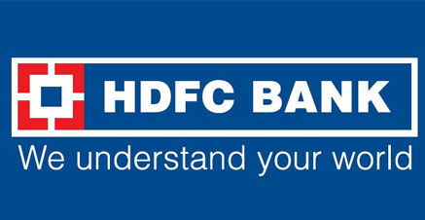
Comprehensive Digital Marketing
Project Work

Slide 2
Team members are:
Suravajhala Sri Bhavya
Giduthuri Joshitha
Bankuru Teja
Yerra Koti Raju
Kanti Mrudhu Vani

Slide 3
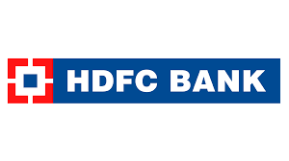
Part 1: Brand study, Competitor Analysis & Buyer’s/Audience’s Persona
Company/Topic for project : HDFC Bank
Brand Colour: Blue,Red,White
Logo:
Mission/Values:HDFC’S Vision and vision are divided as 2 objectives they are
first, to be the preferred provider of banking services for target retail and wholesale customer segments. The second objective is to achieve healthy growth in profitability, consistent with the bank's risk appetite.
USP:The USP of HDFC is commitment to providing innovative banking solutions to empower its customers,Personalized banking experience and showcasing there success stories
Tagline: We Understand Your World !

Slide 4
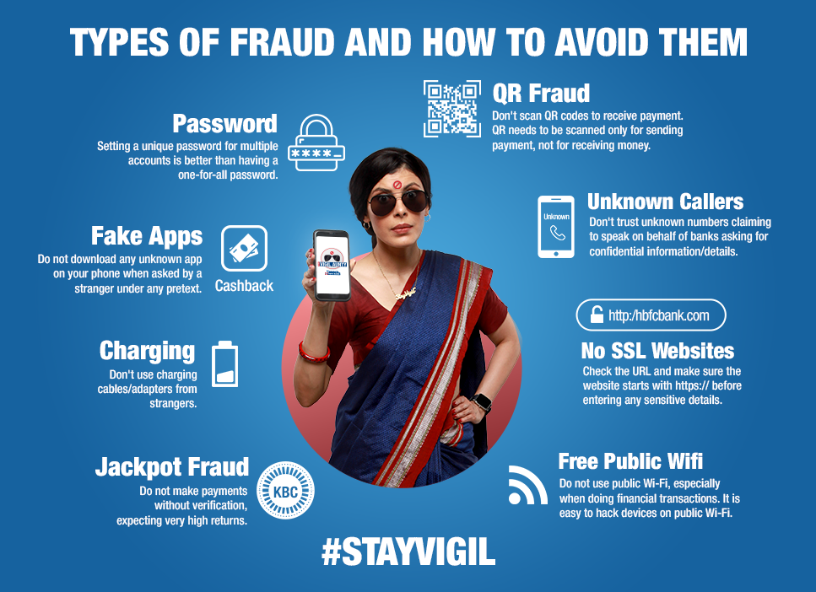
Part 1: Brand study, Competitor Analysis & Buyer’s/Audience’s Persona
Analyze Brand Messaging: HDFC’s messaging style is guiding type and personal
Example:
Examine tagline of HDFC Bank: "We understand your world." This tagline highlights the bank's focus on understanding and catering to the individual needs and preferences of its customers. It emphasizes the bank's commitment to providing personalized banking experiences and innovative solutions that align with the changing dynamics of the customers' lives. The tagline also reflects HDFC Bank's customer-centric approach and its aim to build strong relationships based on trust and understanding.

Slide 5
Part 1: Brand study, Competitor Analysis & Buyer’s/Audience’s Persona
Competitor Analysis:
Competitor 1: https://www.icicibank.com/
USP: Its wide range of products and services that cater to the diverse needs of its customers. and its ability to offer a holistic banking experience with a focus on customer satisfaction, convenience, and technological advancements.
Communication: Is customer-centric, professional and informative.
Competitor 2: https://www.bankofbaroda.in/
USP: Its ability to cater to the needs of individuals and businesses with international operations, providing them with seamless and efficient banking solutions across borders.
Communication: Bank of Baroda is professional, informative, and personalized.
Competitor 3: https://www.pnbindia.in/
USP: Its extensive network and wide range of financial products and services.
Communication:Transperency,informative and guiding .

Slide 6
Part 1: Brand study, Competitor Analysis & Buyer’s/Audience’s Persona
Buyer's/Audience's Persona:
1. Young working professional: This customer is typically in their 20s or 30s, employed in a corporate job, and has a stable income. They are tech-savvy and prefer digital banking solutions for convenience and efficiency. 2. Small business owner: This customer owns a small business or is self-employed. They require banking services that cater to their business needs, such as business loans, merchant services, and online payment solutions. 3. High net worth individual: This customer has significant wealth and requires personalized banking services, including investment advice, wealth management, and exclusive banking privileges. 4. Homebuyer: This customer is looking to purchase a home and requires services such as home loans, mortgage advice, and assistance with property-related transactions. 5. NRI (Non-Resident Indian): This customer resides outside of India but maintains financial ties with the country. They require specialized services such as NRI banking, remittances, and investment options tailored to their unique needs.

Slide 7
Part 2: SEO & Keyword Research
Keyword | Country & Language | Position | Total Searches | Estimated Traffic
hdfc bank net banking | EN | 1 | 30,400,000 | 9,241,600
hdfc bank net banking | HI | 1 | 30,400,000 | 9,241,600
hdfc bank net login | EN | 1 | 30,400,000 | 9,241,600
hdfc bank netbanking | EN | 1 | 30,400,000 | 9,241,600
hdfc netbanking | EN | 1 | 30,400,000 | 9,241,600
hdfc netbanking | HI | 1 | 30,400,000 | 9,241,600
net banking for hdfc bank | EN | 1 | 30,400,000 | 9,241,600
netbanking hdfc | HI | 1 | 30,400,000 | 9,241,600
netbanking hdfc | EN | 1 | 30,400,000 | 9,241,600
netbanking hdfc banking | EN | 1 | 30,400,000 | 9,241,600
SEO Audit:
Keyword Research:
Meta tag: HDFC Banking services|financing|digital marketing
Traffic From Search
This shows you the Estimated Traffic Volume your page receives from it’s Keyword Rankings
168,664,933
Monthly Traffic Volume

Slide 8
Content optimization
HDFC Bank, established in 1994, has grown to become one of the most trusted and largest private sector banks in India. It has consistently been recognized for its strong financial performance and customer satisfaction. One of the key offerings of HDFC Bank is its wide range of savings accounts tailored to meet the diverse needs of individuals. These accounts come with various features such as high interest rates, personalized debit cards, and easy access to funds through net and mobile banking. For businesses and corporate, HDFC Bank provides current accounts that offer seamless transactions and convenient banking solutions. The bank also offers specialized services such as cash management, trade finance, and forex services to support business growth and expansion. HDFC Bank's fixed deposit schemes provide customers with attractive interest rates and flexible tenures to help them grow their savings. These deposits can be opened online or at any HDFC Bank branch, making it convenient for customers. The bank offers a wide range of loan products to cater to different needs, including home loans, personal loans, car loans, and business loans. HDFC Bank ensures a hassle-free loan application process with quick approvals and competitive interest rates. HDFC Bank credit cards are designed to provide customers with exclusive benefits, rewards, and discounts on various categories such as travel, dining, shopping, and entertainment. Customers can choose from a wide range of credit cards tailored to their lifestyle and spending habits. To protect customers from unforeseen events, HDFC Bank offers a comprehensive range of insurance products such as life insurance, health insurance, motor insurance, and travel insurance. These policies provide financial security and peace of mind to customers and their families. HDFC Bank's investment services help customers grow their wealth through various investment options such as mutual funds, stocks, bonds, and fixed income products. The bank provides expert advice and personalized solutions to help customers achieve their financial goals. In line with the digital revolution, HDFC Bank has invested heavily in technology to provide customers with convenient and secure banking services. The bank's digital platforms, including net banking and mobile banking apps, allow customers to access their accounts, make transactions, pay bills, and avail various services from the comfort of their homes. HDFC Bank has a vast network of branches and ATMs across India, ensuring easy accessibility for customers. The bank also offers 24/7 customer support through phone banking and email to address any queries or concerns. With its commitment to excellence and customer-centric approach, HDFC Bank has earned the trust of millions of customers. It continues to innovate and adapt to changing customer needs, making it the preferred choice for reliable and efficient banking services in India.

Slide 9
Challenges were faced while doing SEO Audit
When conducting SEO optimization, there are several challenges that marketers often face. Some of these challenges include: 1. Competition: The online landscape is highly competitive, and ranking well in search engine results pages (SERPs) can be challenging. There may be many other websites targeting the same keywords and trying to rank for the same audience. 2. Constant algorithm updates: Search engines like Google frequently update their algorithms, making it necessary for marketers to stay updated with the latest changes and adapt their strategies accordingly. These updates can sometimes have a significant impact on search rankings and visibility. 3. Keyword research: Finding the right keywords to target can be a challenge. Marketers need to identify keywords that have a good search volume and relevance to their target audience. Additionally, they need to consider the level of competition for those keywords. 4. Technical SEO issues: Technical aspects of a website, such as site speed, mobile-friendliness, and crawl ability, can affect search rankings. Identifying and fixing technical issues can be time-consuming and require technical expertise. 5. Content creation: Creating high-quality and engaging content that is optimized for search engines can be challenging. Marketers need to strike a balance between creating content that appeals to their target audience and incorporating relevant keywords and SEO best practices. 6. Link building: Building high-quality back links is an important aspect of SEO. However, acquiring authoritative and relevant back links can be difficult, especially in competitive industries. 7. Measuring success: Determining the effectiveness of SEO efforts and measuring ROI can be challenging. It can be difficult to attribute specific actions or conversions directly to SEO efforts, especially when multiple marketing channels are involved. To overcome these challenges, marketers can employ various strategies: 1. Stay updated with industry trends and algorithm changes. 2. Conduct thorough keyword research and target long-tail keywords. 3. Implement technical SEO best practices and regularly audit the website for any issues. 4. Create high-quality, valuable, and relevant content that resonates with the target audience. 5. Develop a comprehensive link-building strategy, focusing on acquiring authoritative and relevant back links. 6. Use analytics tools to track and measure the impact of SEO efforts on website traffic, rankings, and conversions. 7. Continuously monitor and optimize SEO campaigns based on data and performance metrics. By addressing these challenges and implementing effective strategies, marketers can improve their chances of success in SEO optimization

Slide 10
Part 3: Content Ideas and Marketing Strategies
Content Idea Generation & Strategy:platform that we are using are instagram,E-mail,facebook ads
Saturday | Sunday | Monday | Tuesday | Wednes day | Thursday | Friday
1we posted a post on instagram for brand awareness | 2 | 3Written a blog on the topic of opening a bank account | 4 | 5 | 6Uploaded a story on instagram for targeting the customers trying to plan their trips | 7BLOG on SMBS and deeper collaboration with fintechs
8Uploaded a video on instagram for brand awareness | 9we postedpost on instagram for public awareness | 10 | 11posted a story on instagram for the knowledge of offer given by us | 12 | 13Posted a post on instagram on our brand success stories | 14
15Uploaded a video on instagram on occation of rakshabandhan offers | 16BLOG for fast faced world of finance | 17posted a story on instagram for the knowledge of offer given by us | 18 | 19we posted a post on instagram on encouraging the business | 20 | 21we posted a post on instagram for brand awareness
22started a ad campaign on facebook for brand awareness | 23started a ad campaign on facebook for lead generation | 24 | 25 | 26Writtten a blog on opening a bank account in instagram | 27 | Started an email campain for brand awareness
29 | 30Started an email campain for brand led generation | 31

Slide 11
Part 3: Content Ideas and Marketing Strategies challenge faced by us on this process
When creating content ideas and marketing strategies for HDFC Bank's digital marketing, several challenges were encountered. One challenge is ensuring that the content is relevant and engaging to the target audience. This requires thorough market research and understanding of customer preferences and needs. Another challenge is standing out in a crowded digital space. With numerous banks and financial institutions vying for customers' attention, it is important to create unique and compelling content that sets HDFC Bank apart from its competitors. Additionally, ensuring that the content is optimized for search engines and social media platforms can be a challenge. This requires knowledge of SEO techniques and social media algorithms to increase visibility and reach. One lesson learned is the importance of data analysis in digital marketing. By analyzing data on customer behavior, engagement rates, and conversion rates, marketers can gain insights into what content resonates with their audience and make informed decisions on future content strategies. Another lesson is the need for continuous experimentation and adaptation. Digital marketing is a dynamic field, and what works today may not work tomorrow. By constantly testing different content ideas and strategies, marketers can identify what resonates best with their audience and make necessary When creating content ideas and marketing strategies for HDFC Bank's digital marketing, several challenges may be encountered. One challenge is ensuring that the content is relevant and engaging to the target audience. This requires thorough market research and understanding of customer preferences and needs. Another challenge is standing out in a crowded digital space. With numerous banks and financial institutions vying for customers' attention, it is important to create unique and compelling content that sets HDFC Bank apart from its competitors. Additionally, ensuring that the content is optimized for search engines and social media platforms can be a challenge. This requires knowledge of SEO techniques and social media algorithms to increase visibility and reach. One lesson learned is the importance of data analysis in digital marketing. By analyzing data on customer behavior, engagement rates, and conversion rates, marketers can gain insights into what content resonates with their audience and make informed decisions on future content strategies. Another lesson is the need for continuous experimentation and adaptation. Digital marketing is a dynamic field, and what works today may not work tomorrow. By constantly testing different content ideas and strategies, marketers can identify what resonates best with their audience and make necessary adjustments. Overall, digital marketing for HDFC Bank requires a deep understanding of the target audience, creativity in content creation, optimization for search engines and social media platforms, data analysis, and a willingness to adapt and experiment. By embracing these challenges and lessons, HDFC Bank can effectively reach and engage its customers in the digital space.
. Overall, digital marketing for HDFC Bank requires a deep understanding of the target audience, creativity in content creation, optimization for search engines and social media platforms, data analysis, and a willingness to adapt and experiment. By embracing these challenges and lessons, HDFC Bank can effectively reach and engage its customers in the digital space.10:12 AM

Slide 12
Part 4: Content Creation and Creation (Post creations, Designs/Video Editing, Ad Campaigns over Social Media and Email Ideation and Creation)
Post Creation:
Select Content Categories: Content that we have chosen reflects on giving awareness to the public by educating how to respond on frauds, financial serves for startups ,giving information about our offers to grab the traffic.
Format 1: We have chosen a blog article on opening a bank account easily
Format 2: We have chosen post format for brand awareness,public awareness,startups
Format 3: We have chosen videos for public services that were provided by our bank

Slide 13
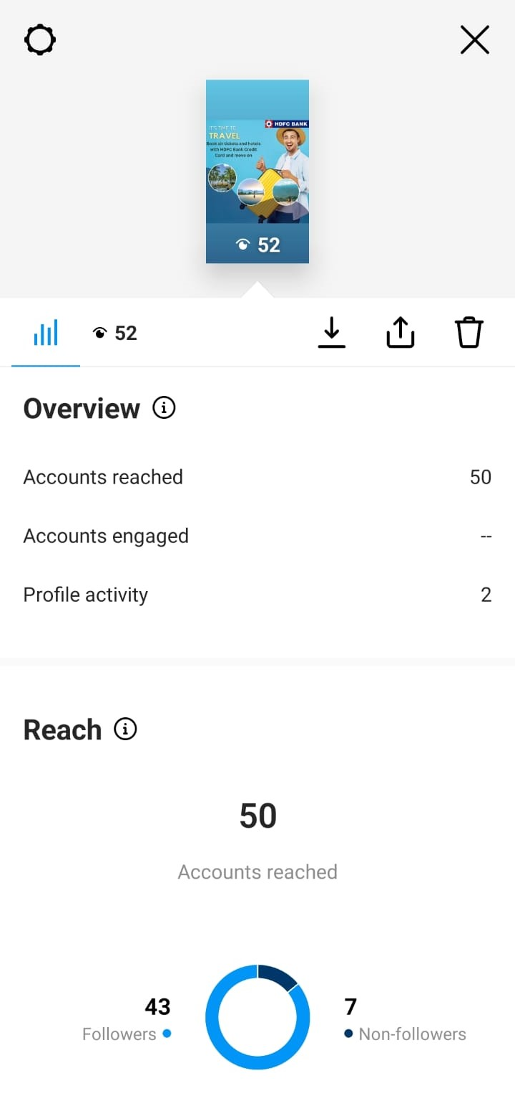

Part 4: Content Creation and Curation (Post creations, Designs/Video Editing, Ad Campaigns over Social Media and Email Ideation and Creation)
Instagram Story 1
To give awareness about holidays planning to public
https://www.instagram.com/s/aGlnaGxpZ2h0OjE3OTkyNTM4ODk3MzAxMDY0?story_media_id=3154001769961809371_61031920965&igshid=MTc4MmM1YmI2Ng==

Slide 14

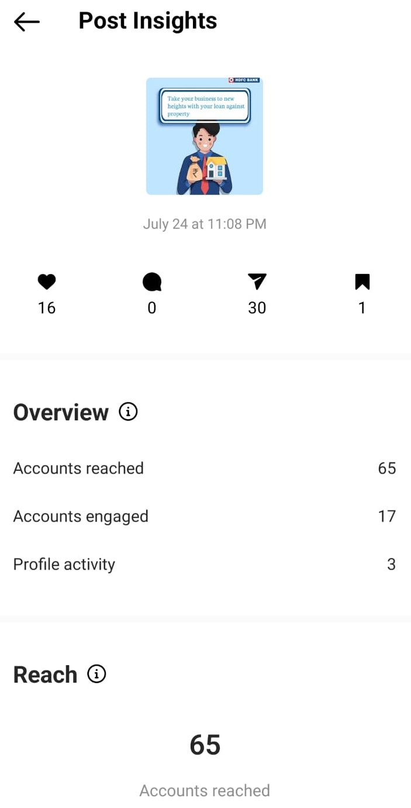
Instagram post 1
https://www.instagram.com/p/CvHBaQVB4sn/?igshid=MTc4MmM1YmI2Ng==

Slide 15
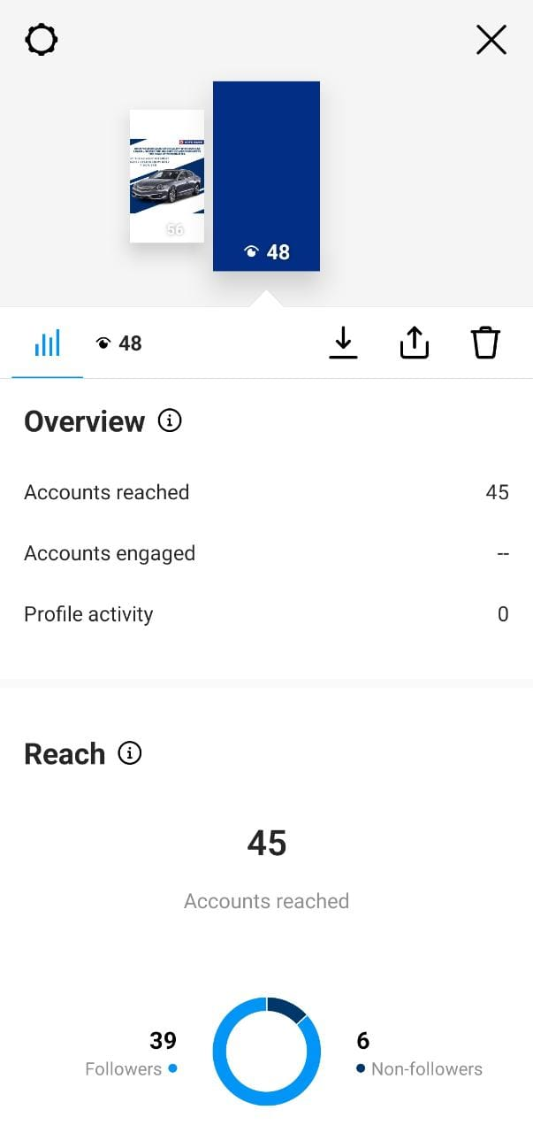

Instagram story 2
https://www.instagram.com/s/aGlnaGxpZ2h0OjE3OTcxMDkxNDgzNTg1NzQ1?story_media_id=3154002116730087633_61031920965&igshid=MTc4MmM1YmI2Ng==

Slide 16

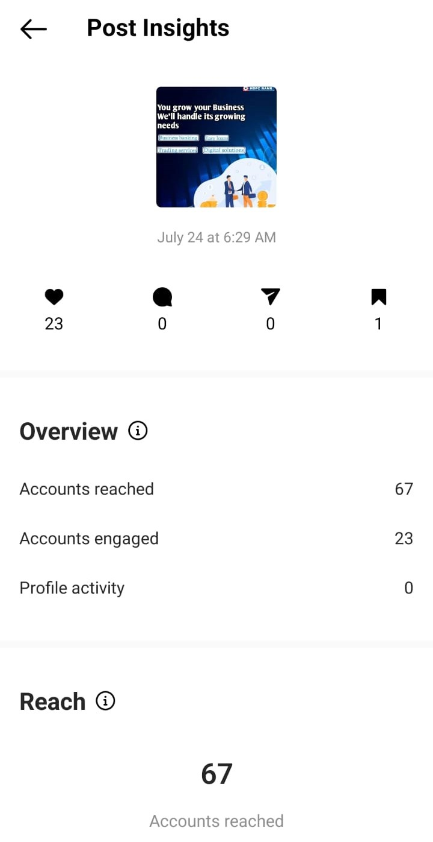
Instagram post 2
https://www.instagram.com/p/CvFPHCyhZd6/?igshid=MTc4MmM1YmI2Ng==

Slide 17
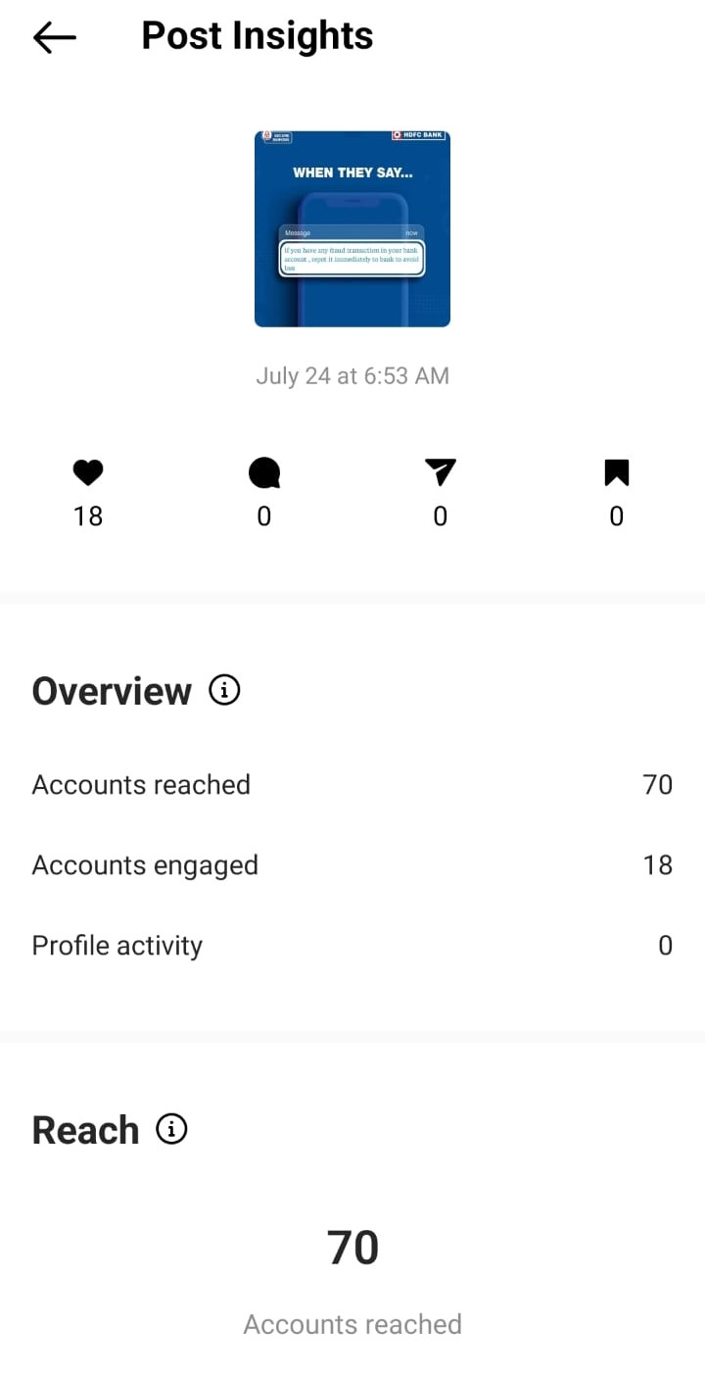
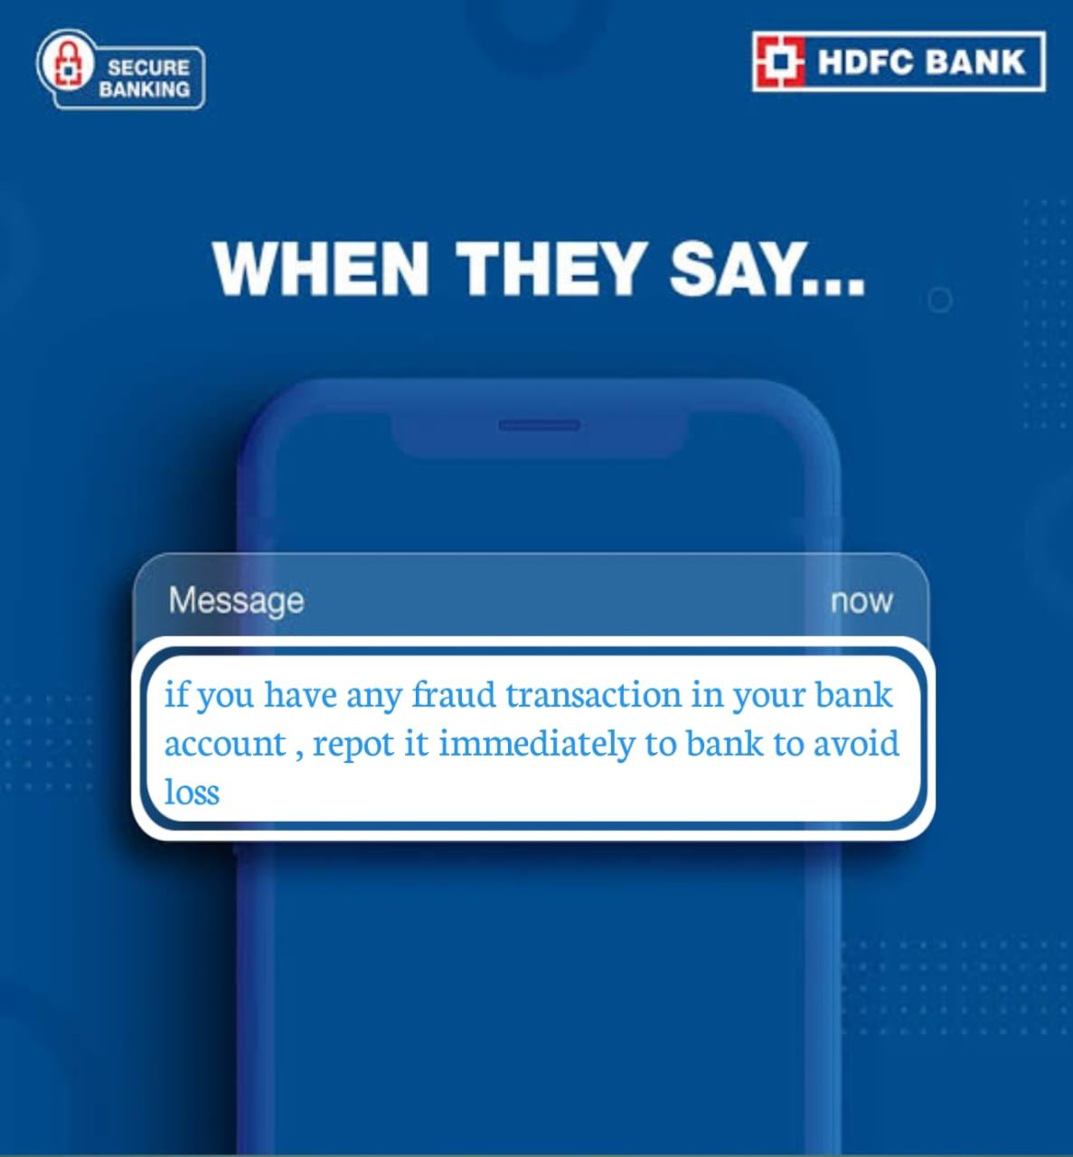
Instagram posts 3

Slide 18
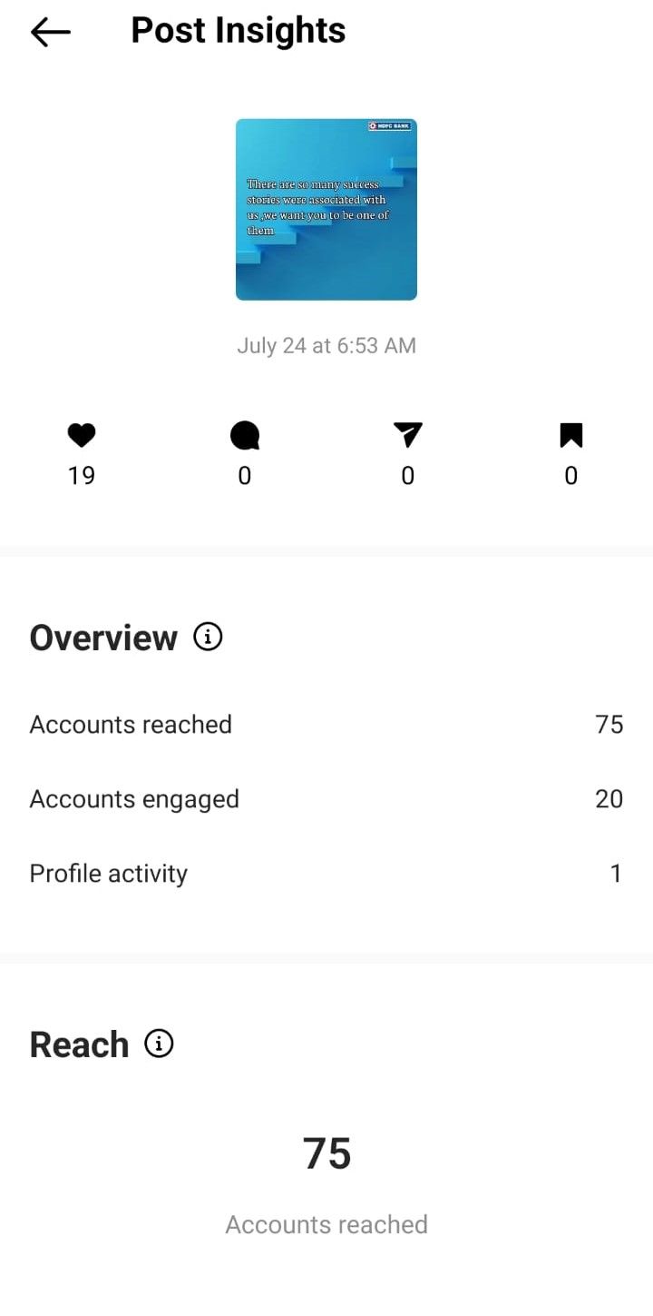
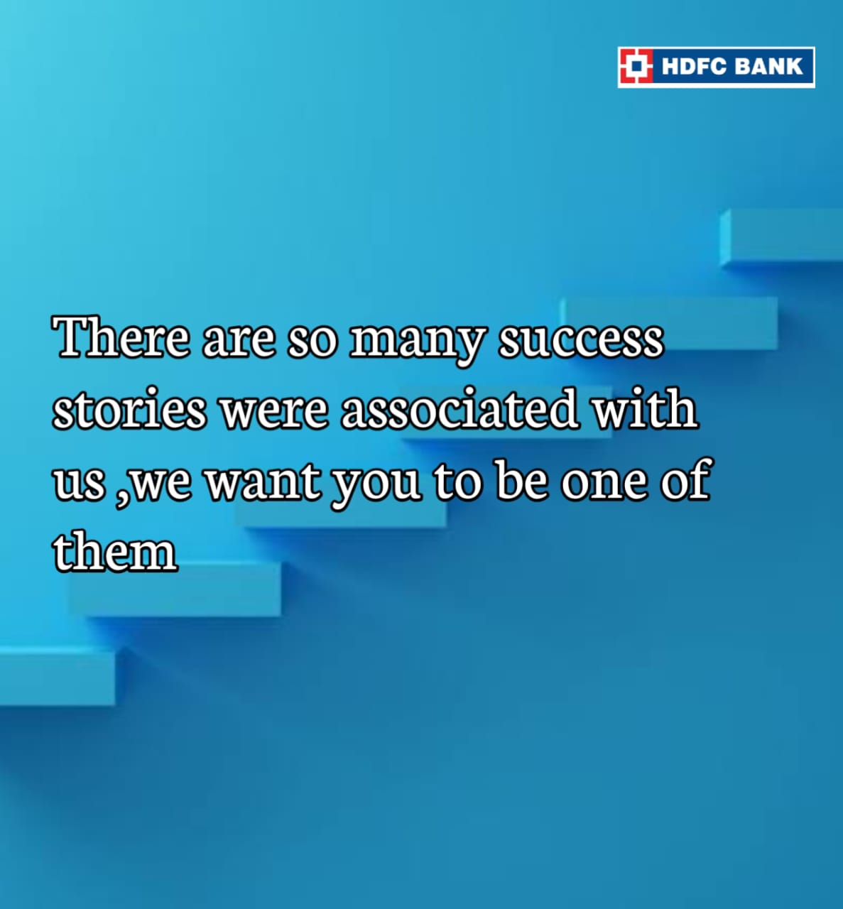
Instagram post 4
https://www.instagram.com/p/CvFR7Whhx1S/?igshid=MTc4MmM1YmI2Ng==

Slide 19

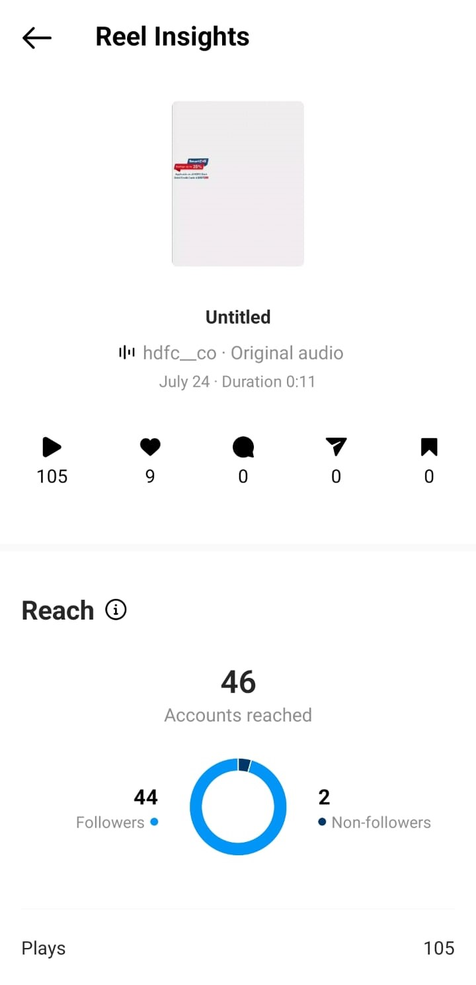
Part 4: Content Creation and Curation (Post creations, Designs/Video Editing, Ad Campaigns over Social Media and Email Ideation and Creation)
Designs/Video Editing
https://www.instagram.com/reel/CvHBEhlhNRC/?igshid=MTc4MmM1YmI2Ng==

Slide 20
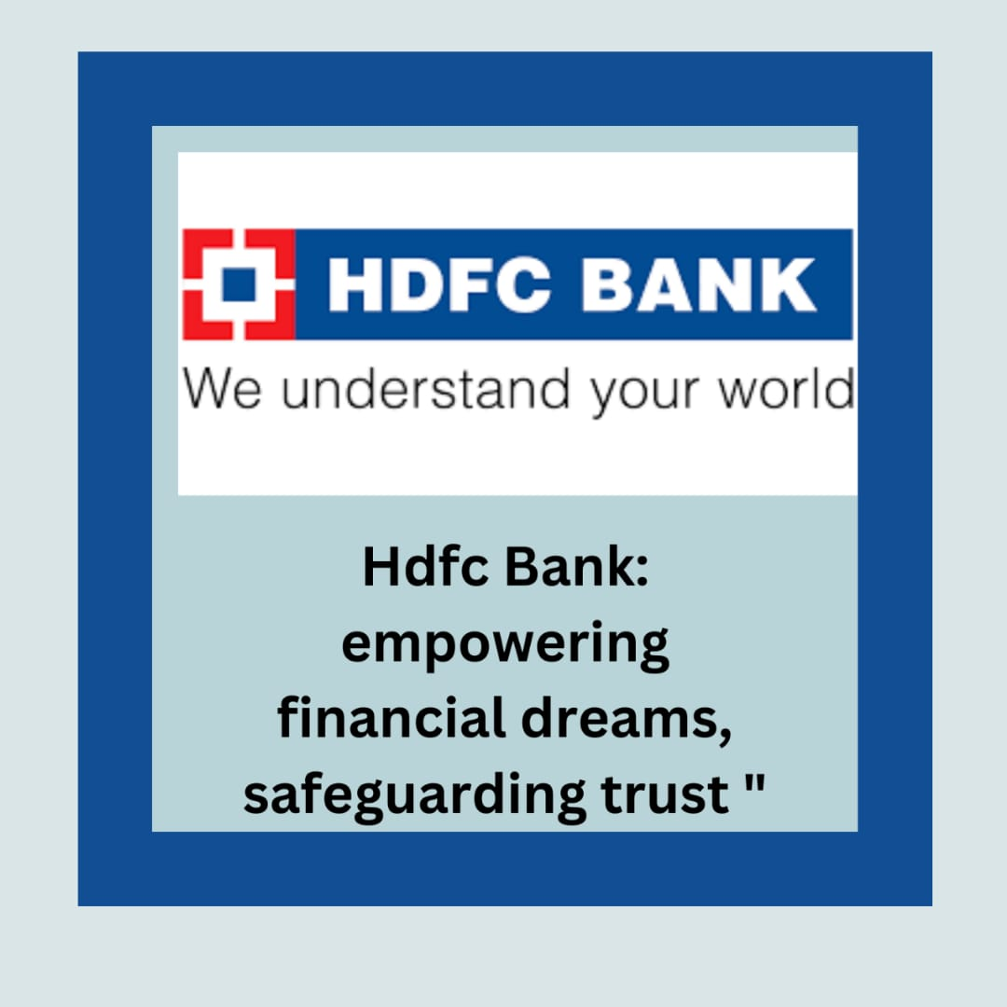
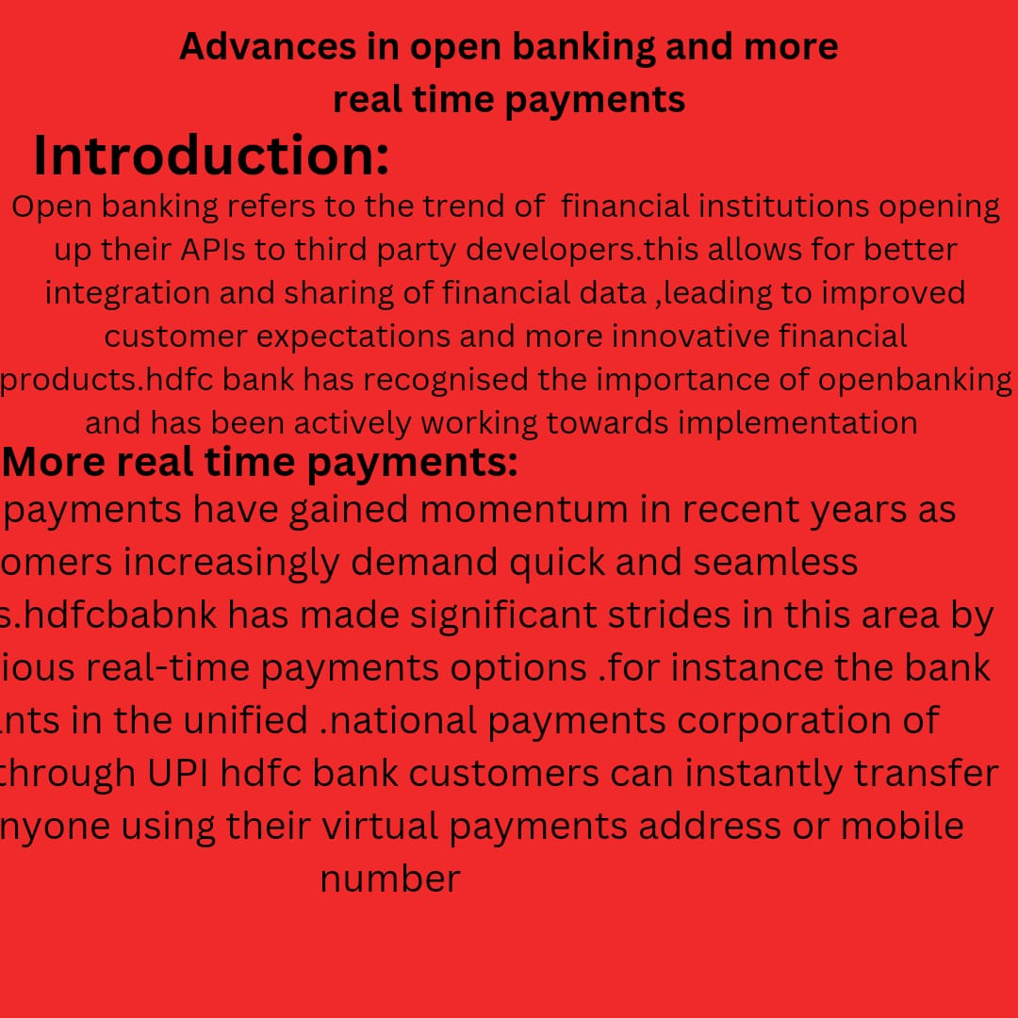
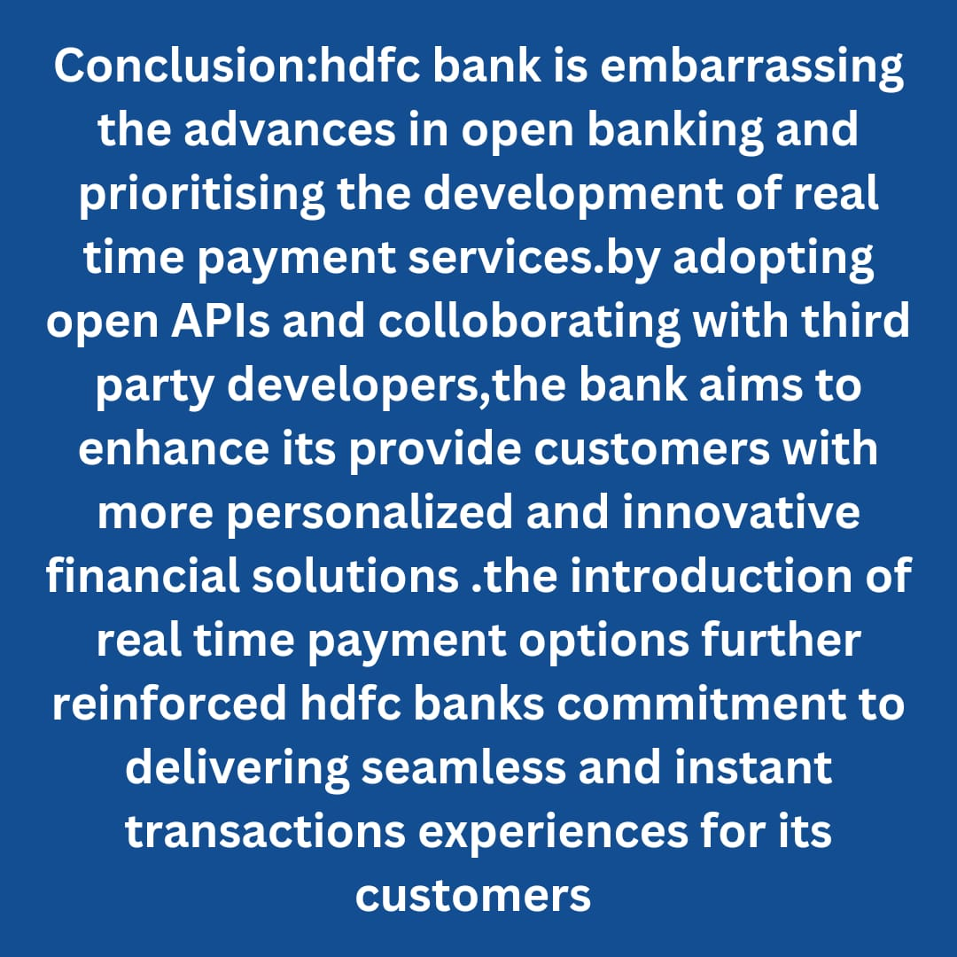
BLOG for opening account

Slide 21
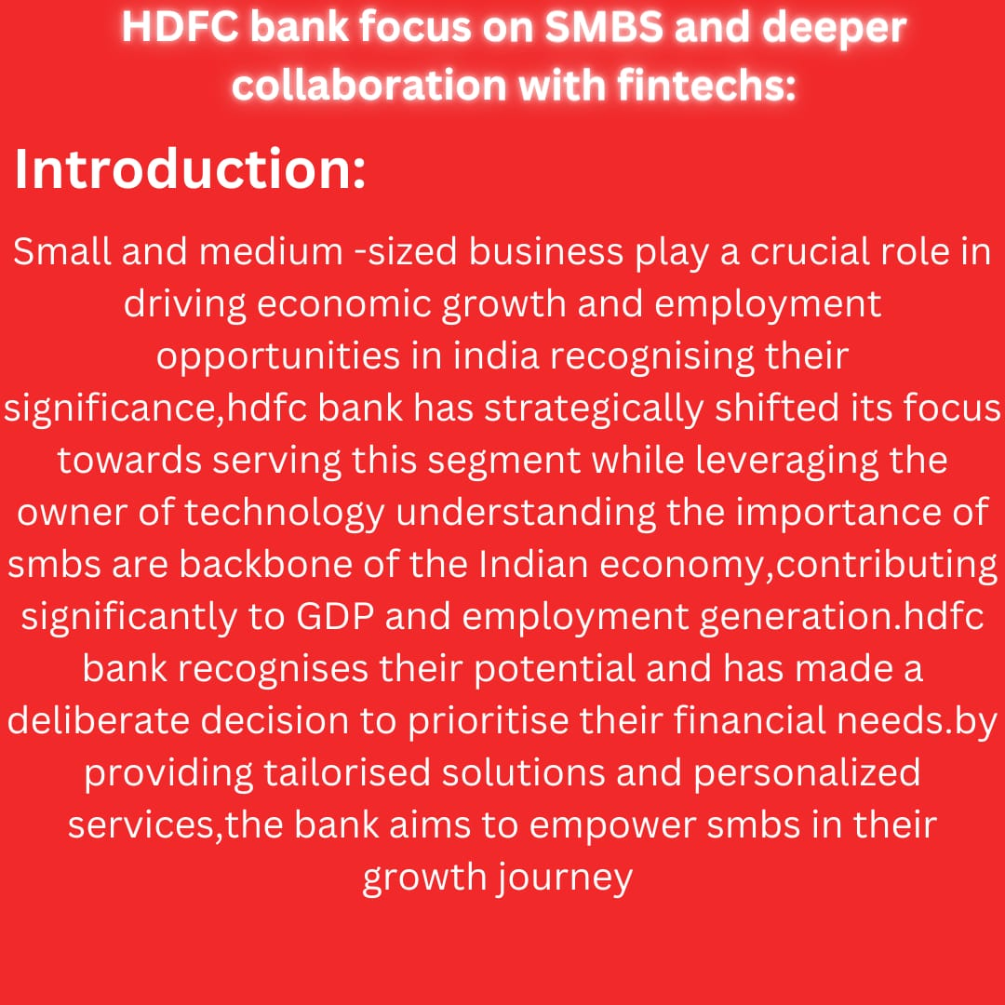
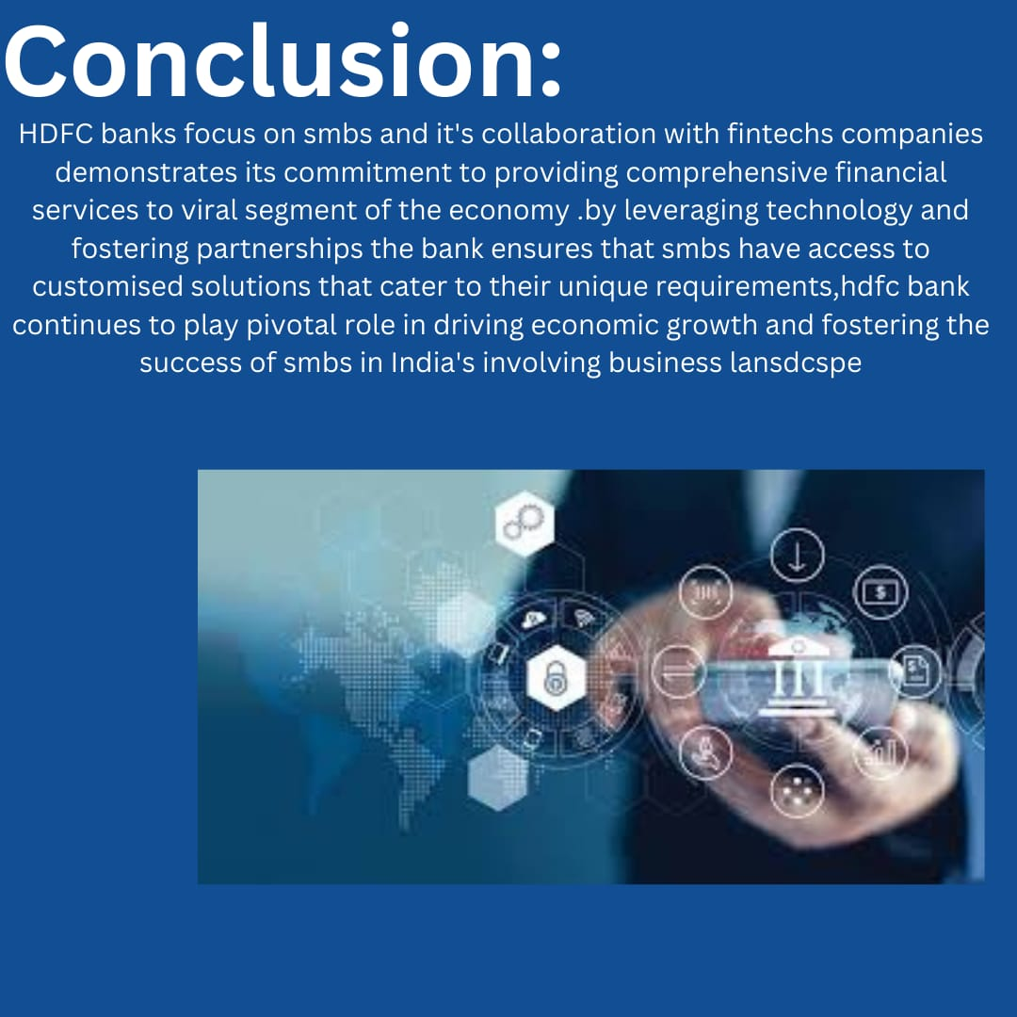
BLOG on SMBS and deeper collaboration with fintechs

Slide 22
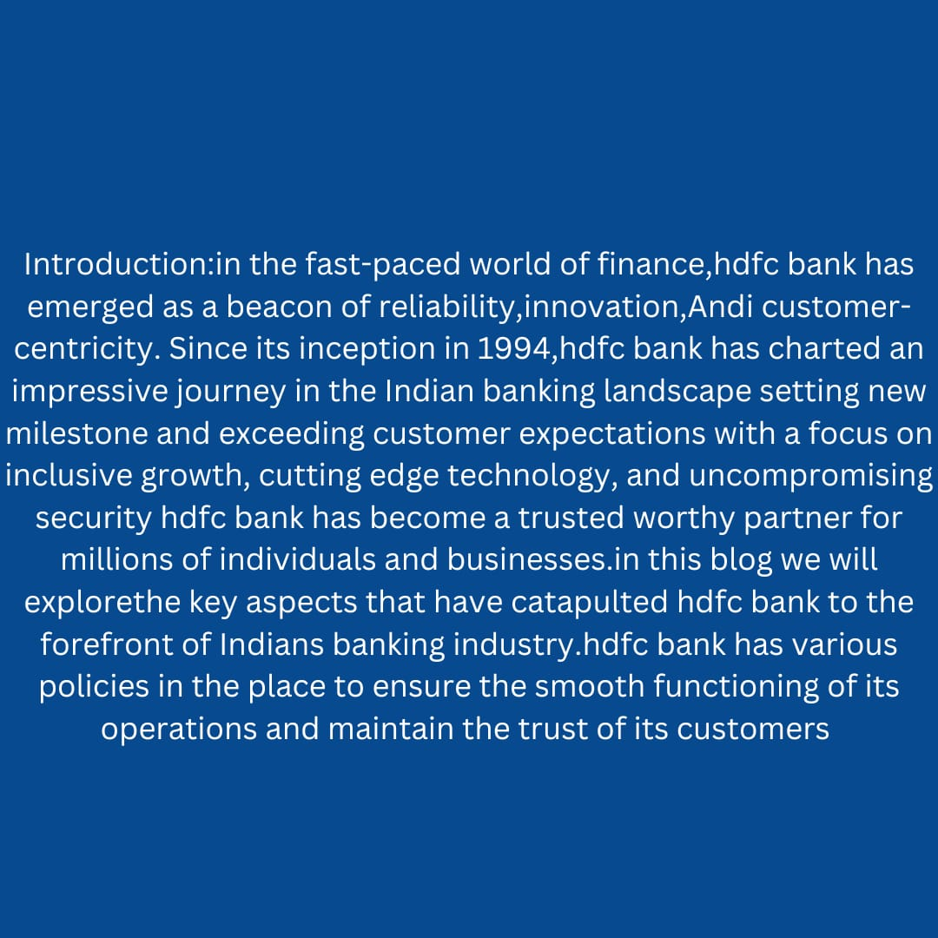

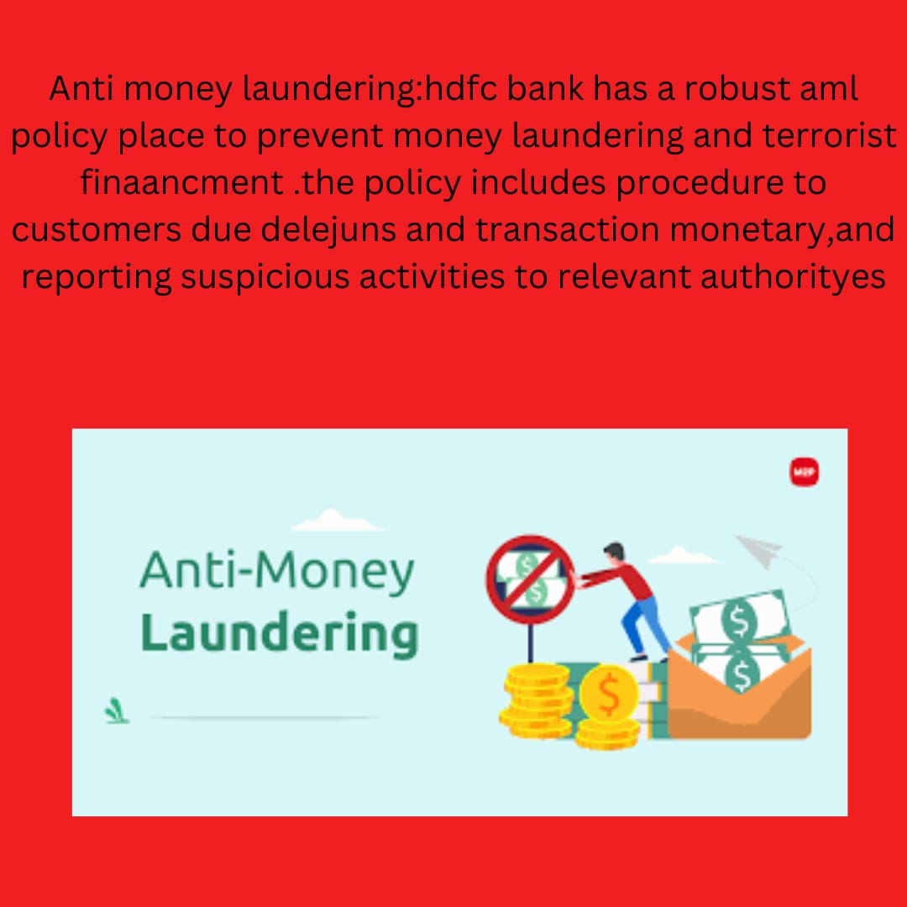
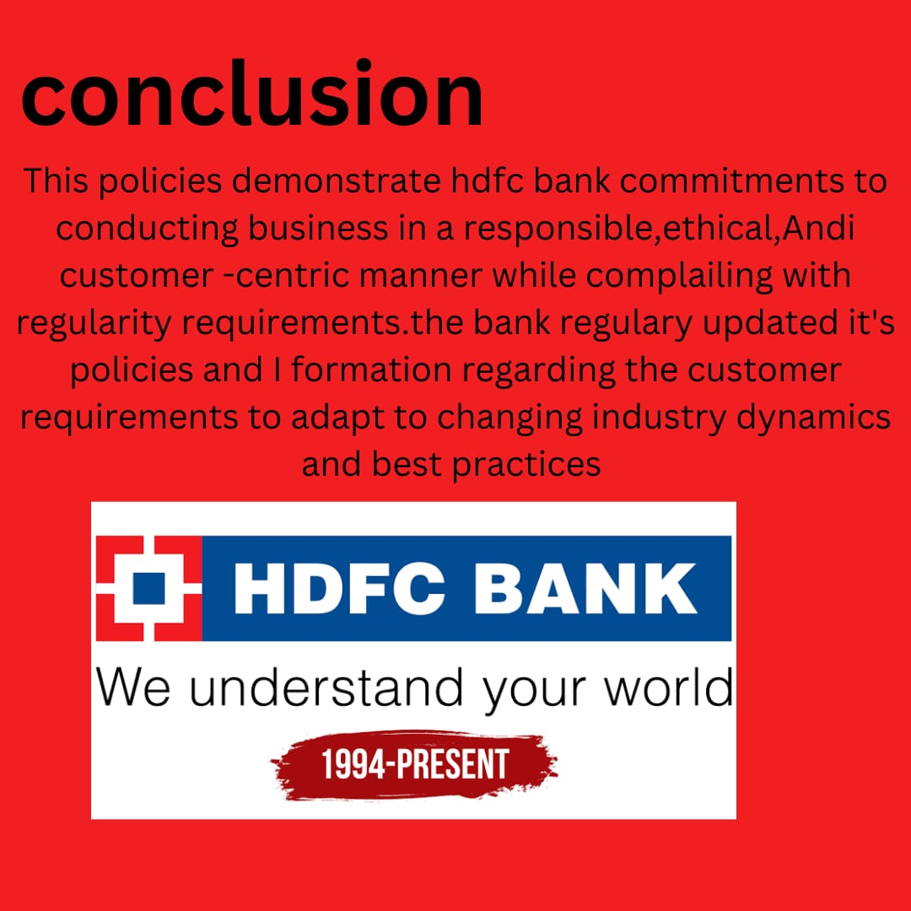
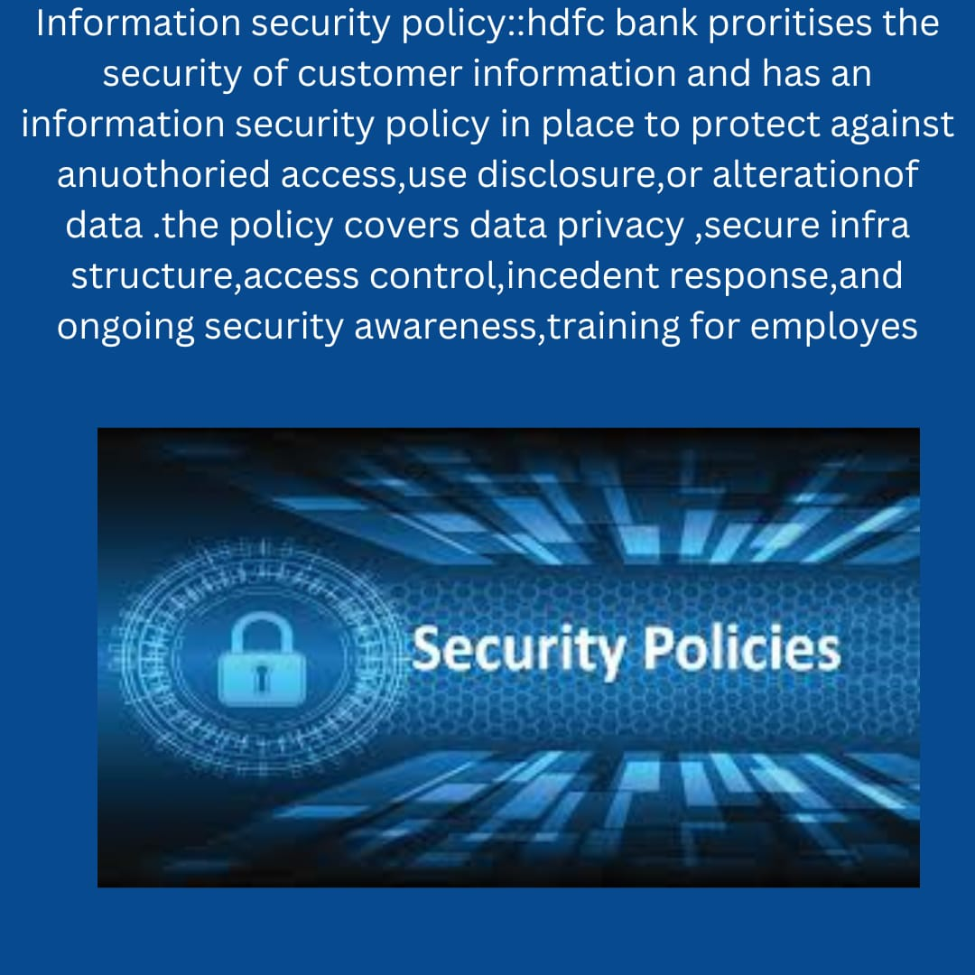
BLOG for fast faced world of finance

Slide 23
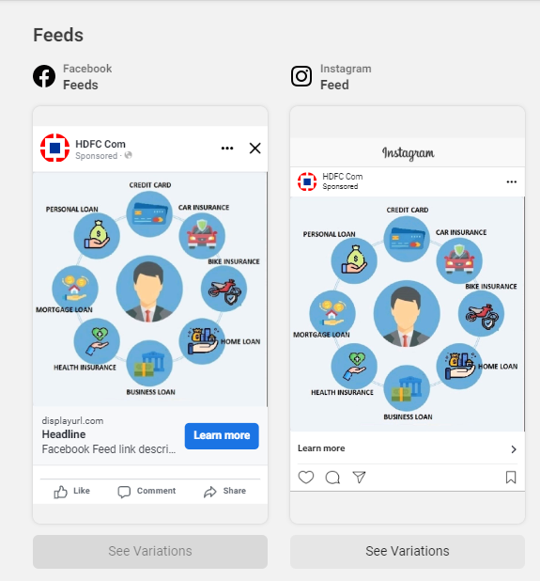
Part 4: Content Creation and Curation (Post creations, Designs/Video Editing, Ad Campaigns over Social Media and Email Ideation and Creation)
Social Media Ad Campaigns
Its an awareness campaign:
To acknowledge the customers about how may type are available in our bank
Targeting audiance: All 18+ aged

Slide 24
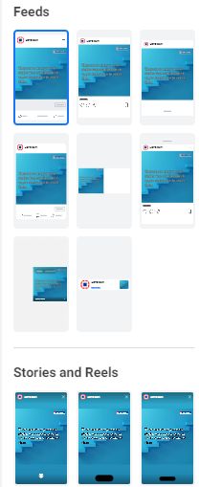
Social Ad Campaigns
Its designed for grabbing traffic
Target auidence :all 18+ ages
To showcase our success with our customers

Slide 25
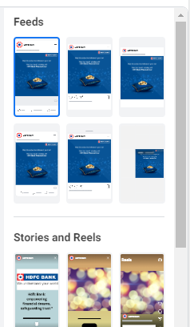
Social Ad Campaigns
It is designed for lead generation
Target audience: people looking for startups
To encourage startups

Slide 26
video campaign for facebook

Slide 27
Part 4: Content Creation and Curation (Post creations, Designs/Video Editing, Ad Campaigns over Social Media and Email Ideation and Creation)
Email Ad Campaigns:
We have generated 2 email campaigns:
1.giving awareness to the public with the regards that how many types of loans were provided by us
2. For lead generation to grab the attention of the startup companies to look at our bank for there financial needs

Slide 28
Email Ad Campaign 1 - Brand Awareness

Slide 29
Email Ad Campaign 2 - Lead Generation

Slide 30
Part 4: Content Creation and Creation (Post creations, Designs/Video
Editing, Ad Campaigns over Social Media and Email Ideation and Creation) challenges were faced on doing email campaign and facebook ad campaign
In addition to the challenges mentioned above, the content creation and creation process for email and ads campaigns also face specific challenges and require unique strategies. One of the main challenges in email campaigns is delivering content that is personalized and relevant to each individual recipient. This requires segmenting the email list based on customer preferences, demographics, and behavior, and creating tailored content for each segment. It can be time-consuming and resource-intensive to gather and analyze customer data to create these personalized campaigns, but it is essential for driving engagement and conversions. Another challenge in email campaigns is avoiding the spam folder and ensuring deliverability. Email filters have become increasingly sophisticated, and it is important to follow best practices in email marketing to avoid being flagged as spam. This includes using clear and concise subject lines, avoiding excessive use of promotional language, and regularly cleaning up the email list to remove inactive or unengaged subscribers. For ads campaigns, one of the main challenges is capturing attention in a limited space. Ads often have limited characters or visual space to convey the message, so it is important to create compelling and concise content that grabs the audience's attention quickly. This requires creativity in copywriting and design to make the most impact in a short amount of time. Another challenge in ads campaigns is optimizing for conversions. It is not enough to simply drive traffic to a website or landing page; the content of the ad must also be persuasive enough to encourage users to take the desired action, such as making a purchase or filling out a form. This requires understanding consumer psychology and incorporating persuasive elements into the ad content. Some lessons learned for email and ads campaigns include the importance of A/B testing and continuous optimization. By testing different subject lines, copywriting styles, visuals, and calls-to-action, marketers can identify what resonates best with their audience and make data-driven decisions on future campaigns. It is also important to regularly analyze campaign performance metrics, such as open rates, click-through rates, and conversion rates, to identify areas for improvement and make adjustments accordingly. In conclusion, email and ads campaigns face challenges such as personalization, deliverability, attention-grabbing content, and optimization for conversions. By addressing these challenges and continuously experimenting and optimizing, marketers can create effective and engaging campaigns that drive results

Slide 31
Thank you

